Slide 1



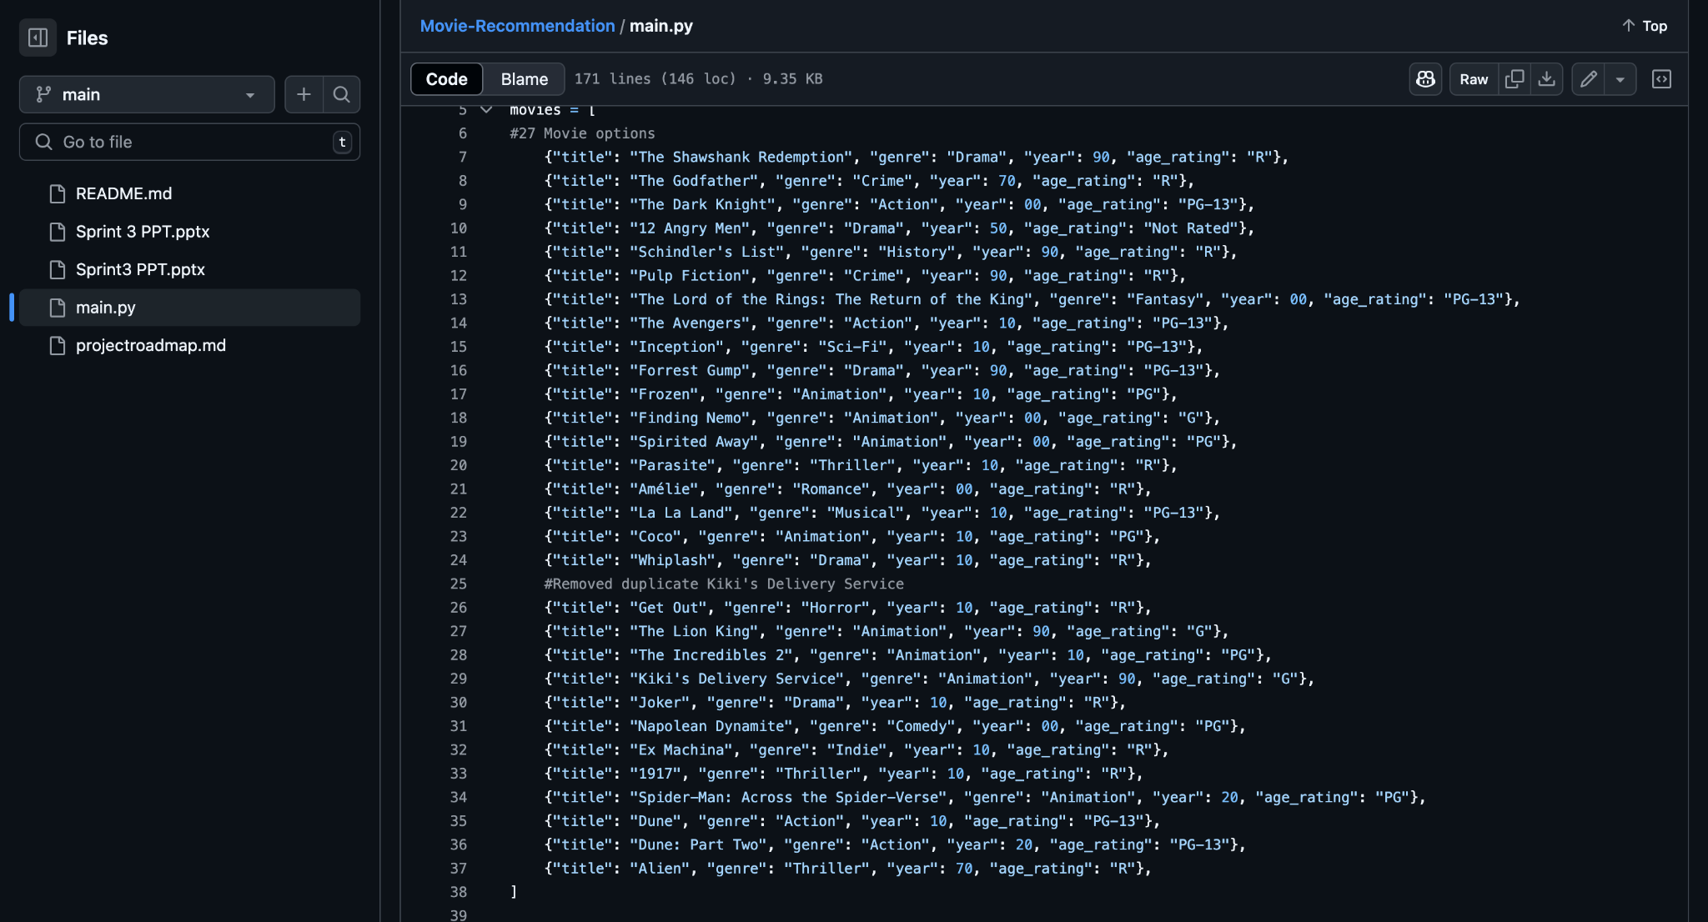


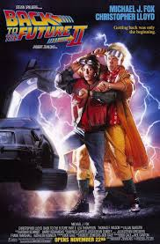

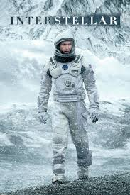


By: Benaiah Noah
Find Your Film
Made to help movie lovers easily and quickly find a movie. Whether you want a random film or a specific genre this quiz will get the job done!
https://github.com/ksu-is/Movie-Recommendation

